Slide 1
Exercise 4

Slide 2
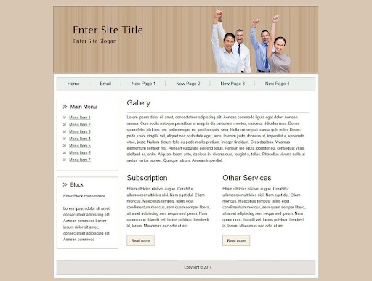
Define the component on this template

Slide 3
TODO: Define and draw components

